Slide 1

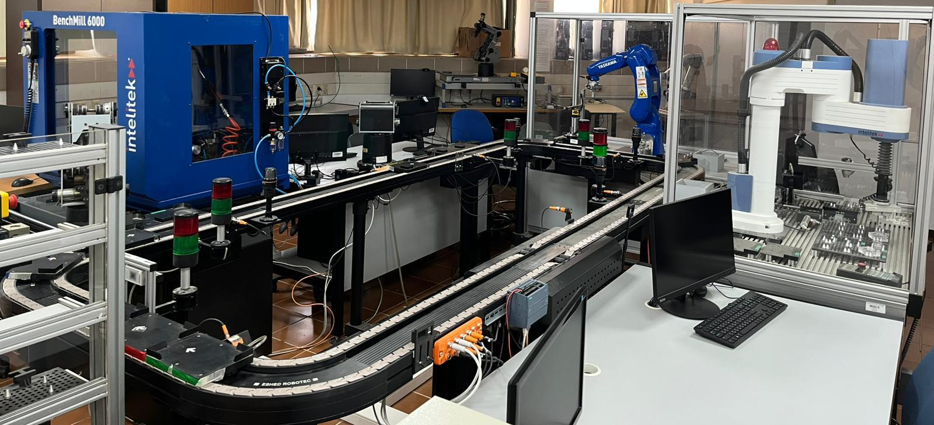
Production Line
Augmented Reality Application
By:
Shlomi Fridman
Shahar Berenson
Advisor:
Dr. Naomi Unkelos Shpigel

Slide 2


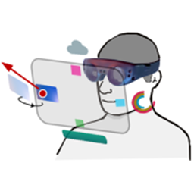
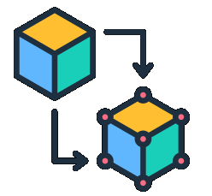


Background
Augmented Reality (AR) For Monitoring - Overlays real-time data on physical environments to improve performance on operations. [Syed 2022][Li 2024]
Digital Twin - Virtual replica of a physical object, that mirrors its real-time behavior and state using data from sensors. [Yin 2023]
The Industrial Internet of Things (IIoT) - Boosts manufacturing efficiency and data-driven operations. [Peter 2023]
Augmented Reality For IIoT - Enhances system control and visualization through real-time AR integration. [Fuentes 2024]
Notes:
Shahar

Slide 3
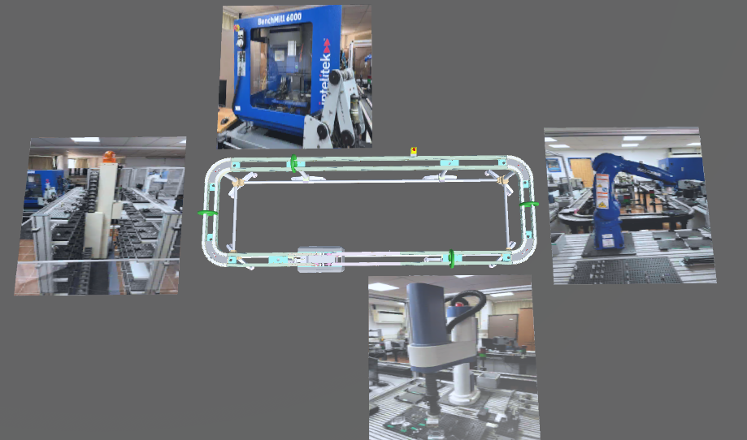
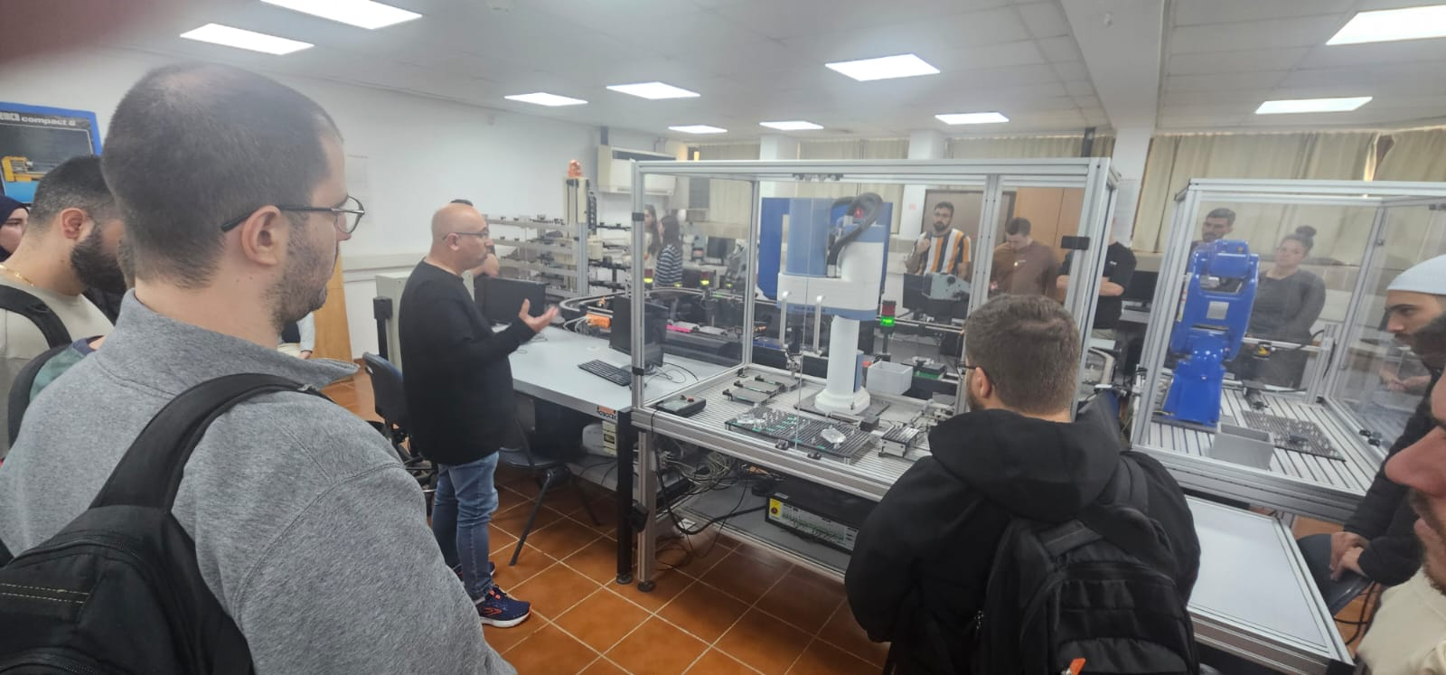
The Challenge
Understanding production line operations can be a complex task. Especially for students unfamiliar with the underlying processes.
Educational staff are not always present on-site. Faults may go undetected and unresolved for hours or even days.
Notes:
Shahar
Make it easier for new students to learn the production line process
Provide monitoring app for the staff, in case an fault happens

Slide 4
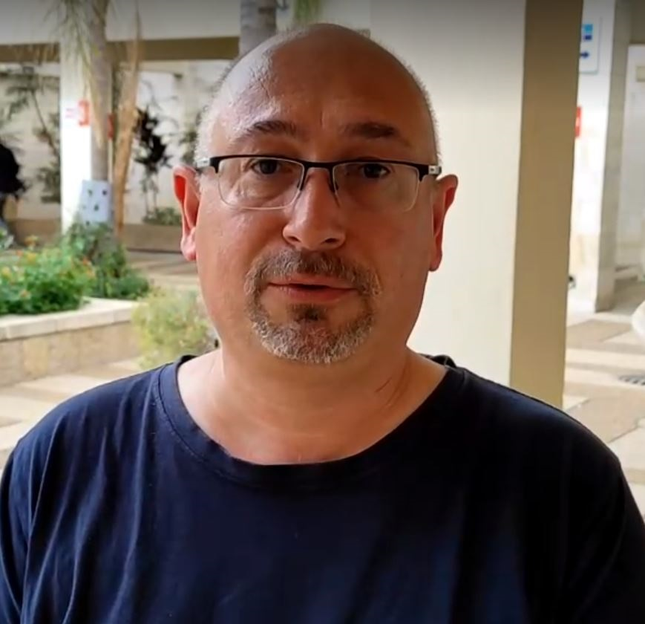

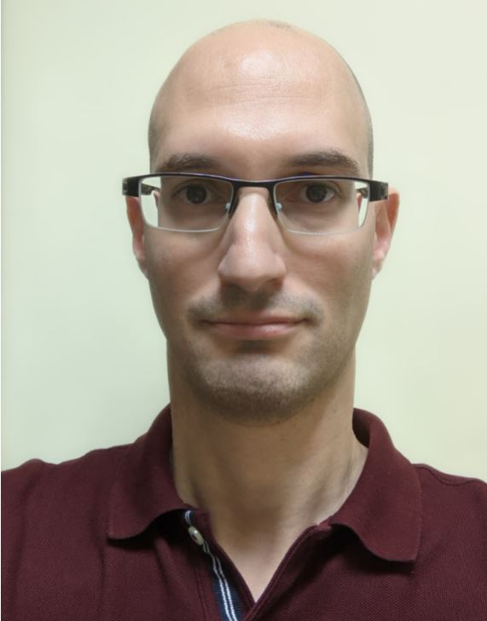
The Production Line (1/3)
1
2
3
4
Built by Eshed-Robotec at 1997.
Four tracked stations:
Storage
Cutting
Provision
Assembly
Lab used by students and lecturers from
🔧 Mechanical Engineering &
🏭 Industrial Engineering programs.
Computer-Integrated Manufacturing (CIM) Lab D106
Managed by:
Daniel Wasserman
Dan Cuperman
Elad Denenberg
Notes:
Shahar

Slide 5
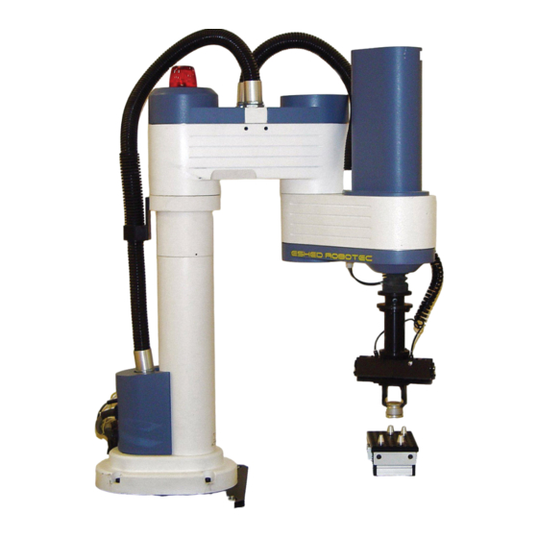
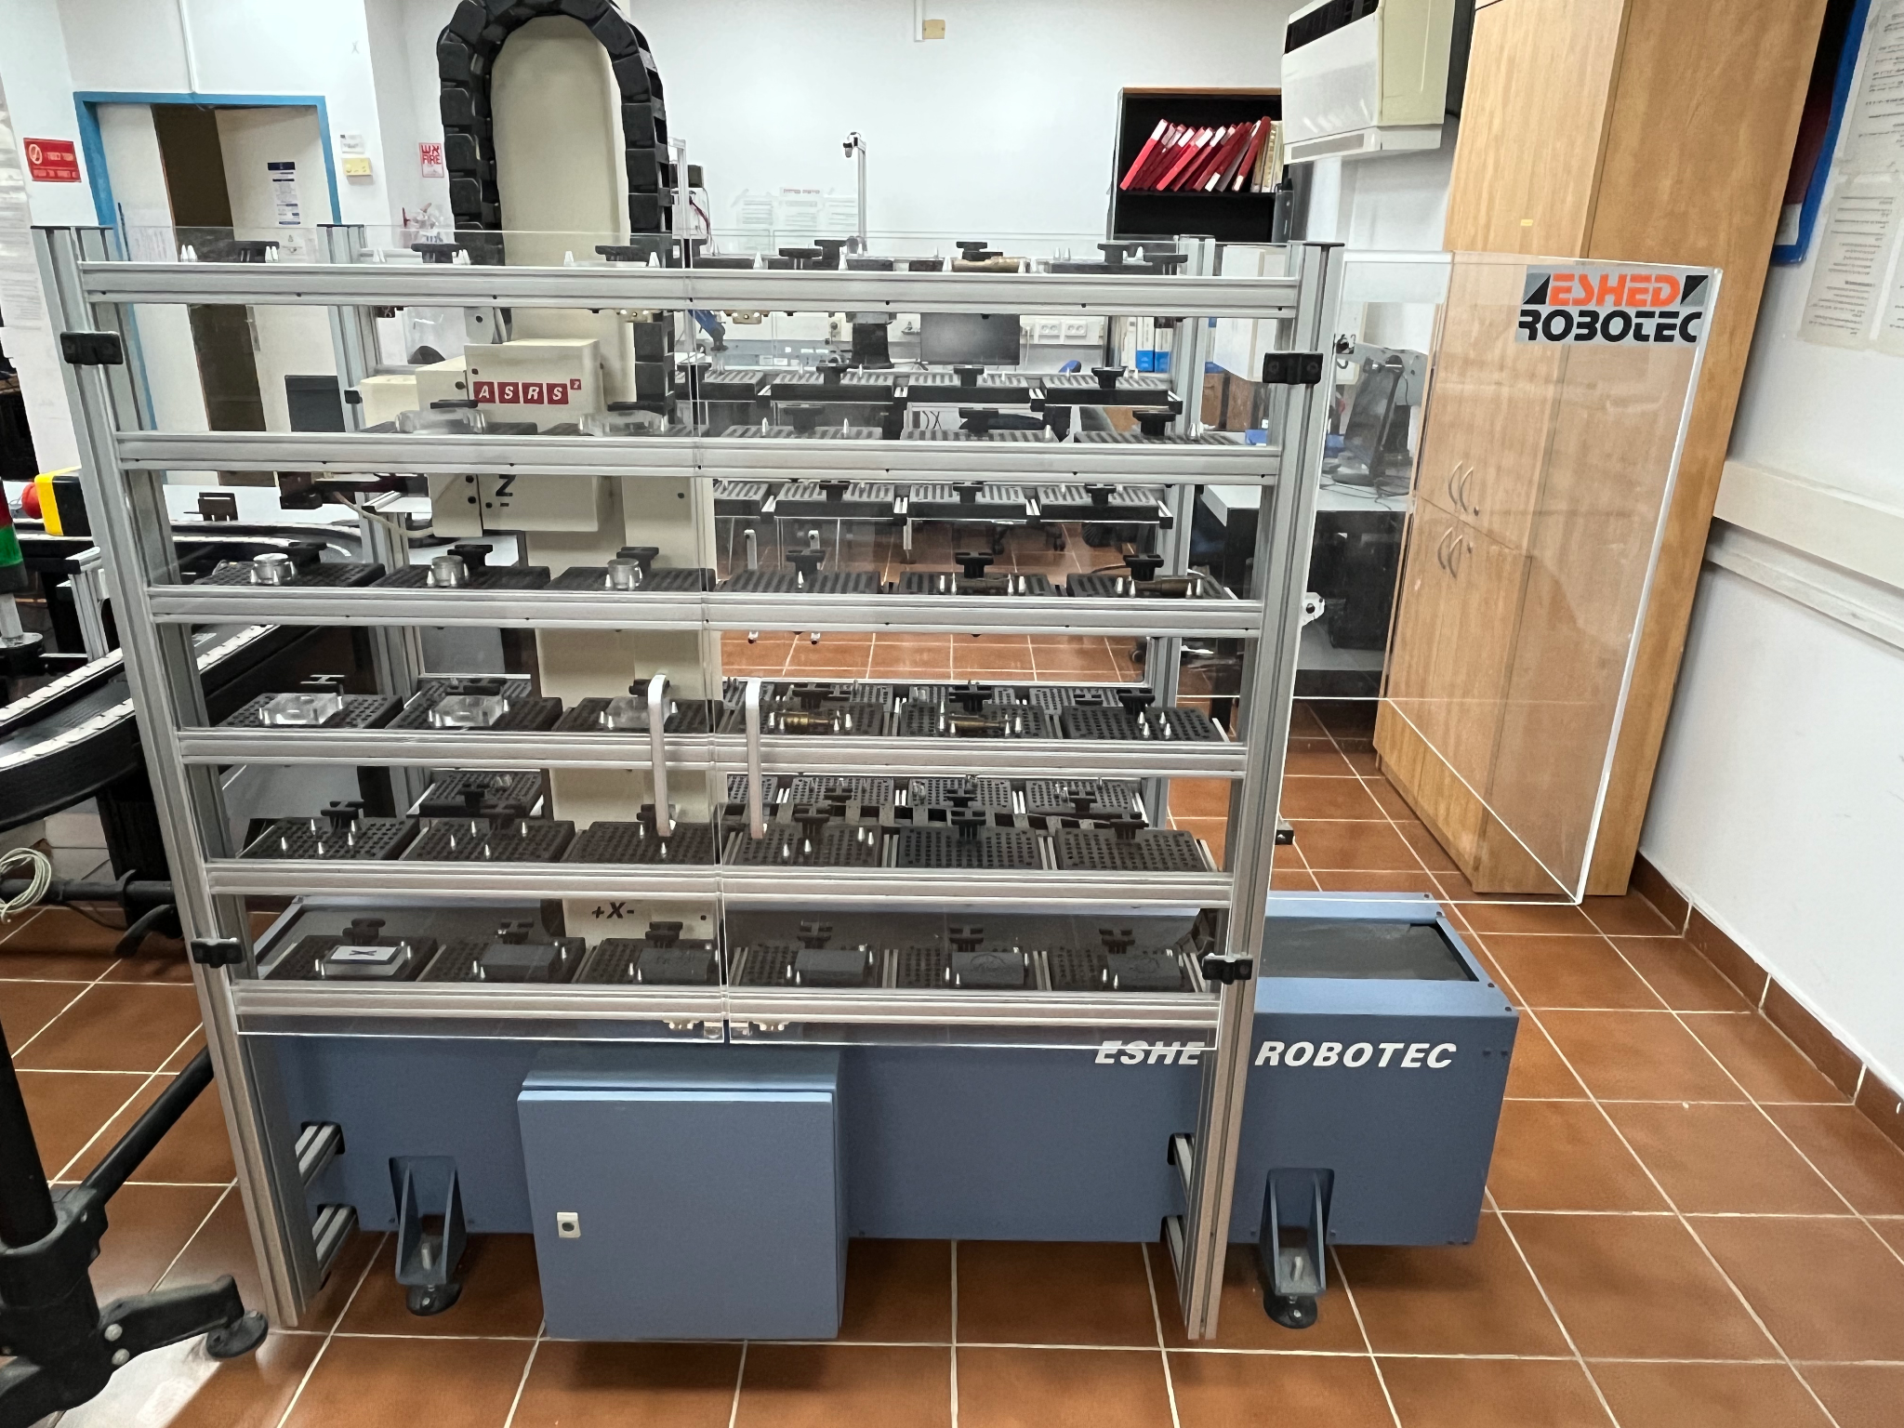
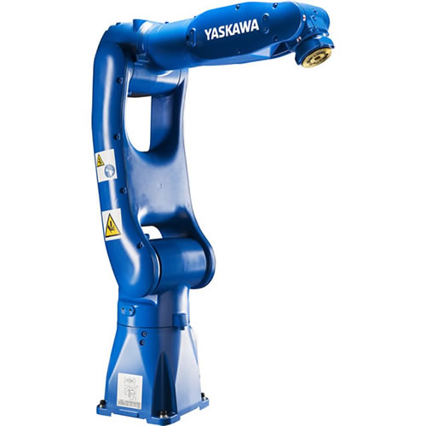
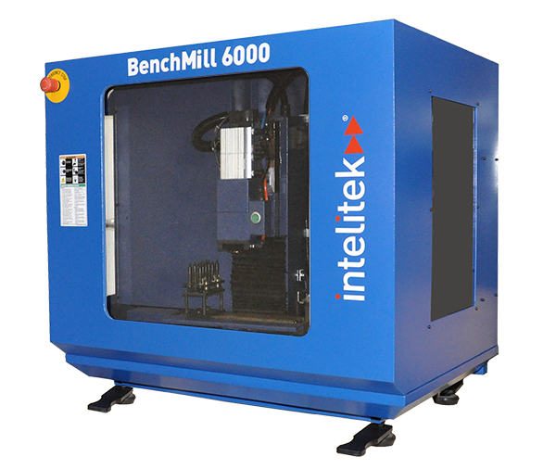
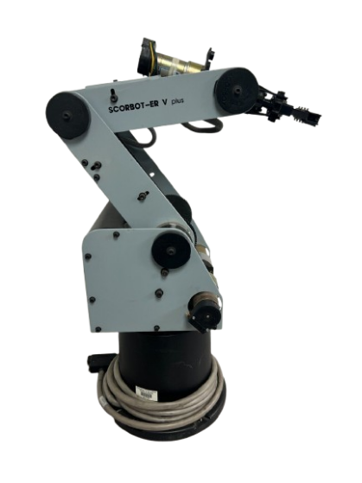
Storage
Machines
Robotic Arms
Milling Machine
Media of the stations (text, image, video)
Quiz about stations,
badges based on correct answers
SCORA ER-14
ASRS 2
Yaskawa Motoman
SCORBOT-ER V
Notes:
Shahar

Slide 6
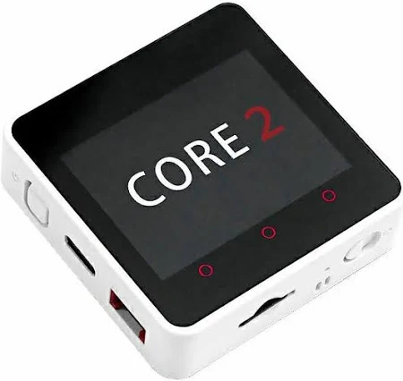
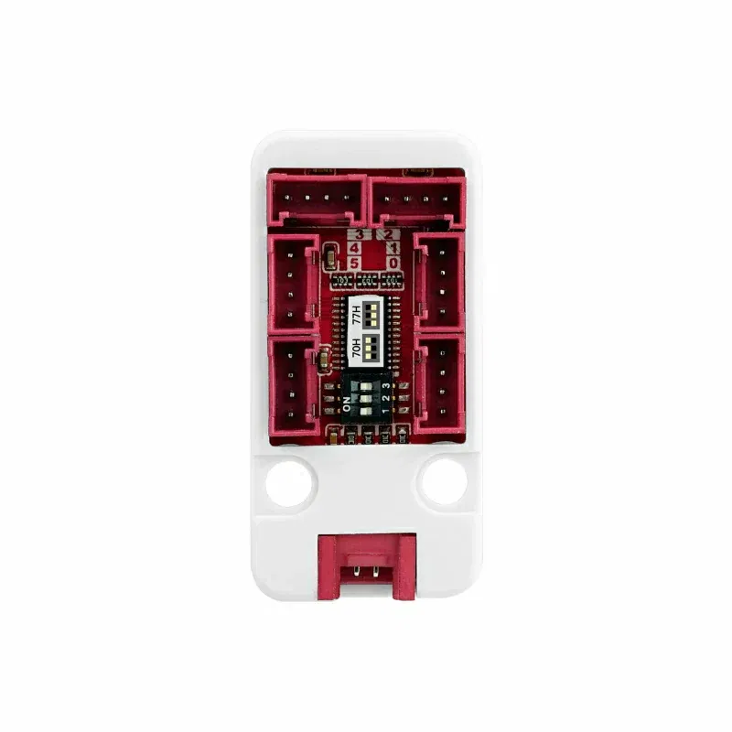
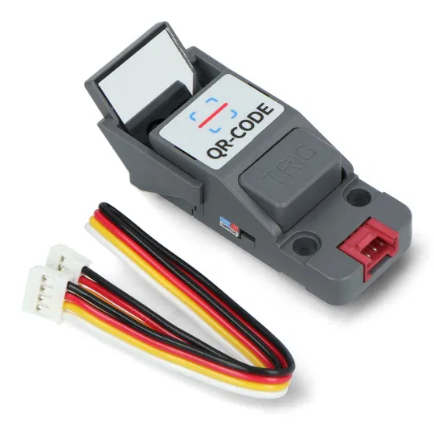
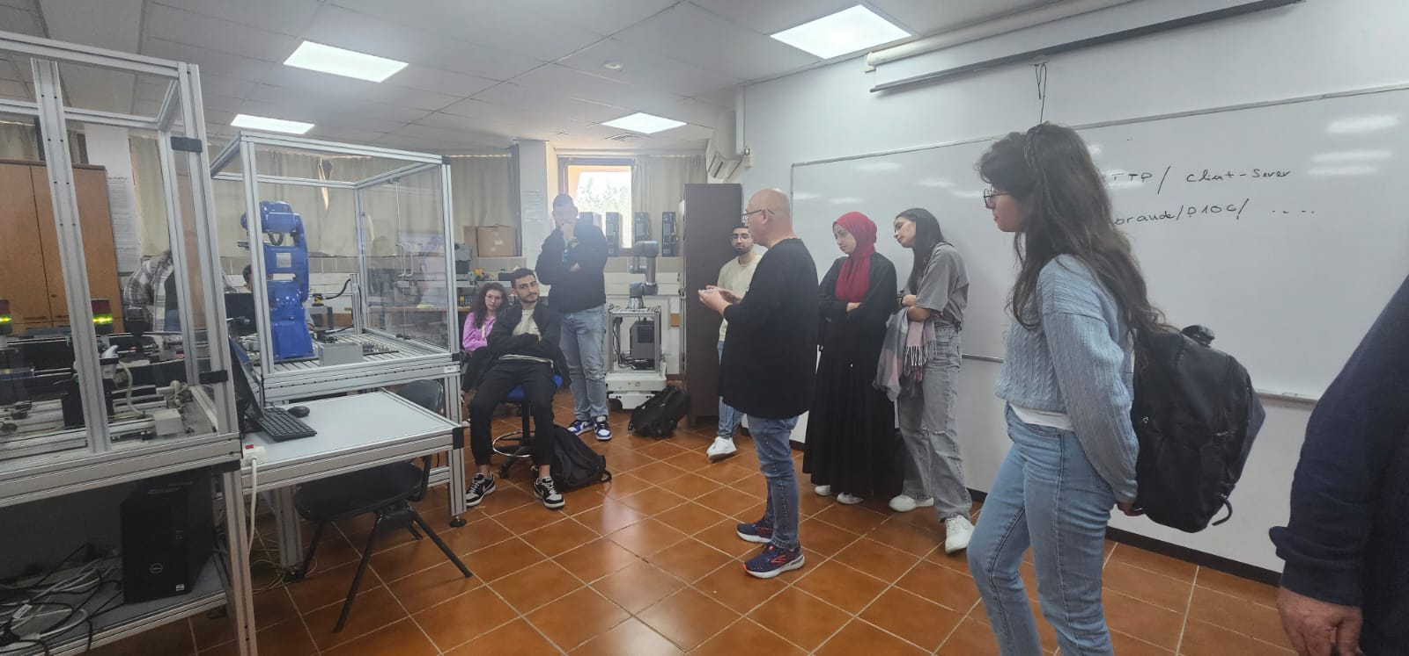
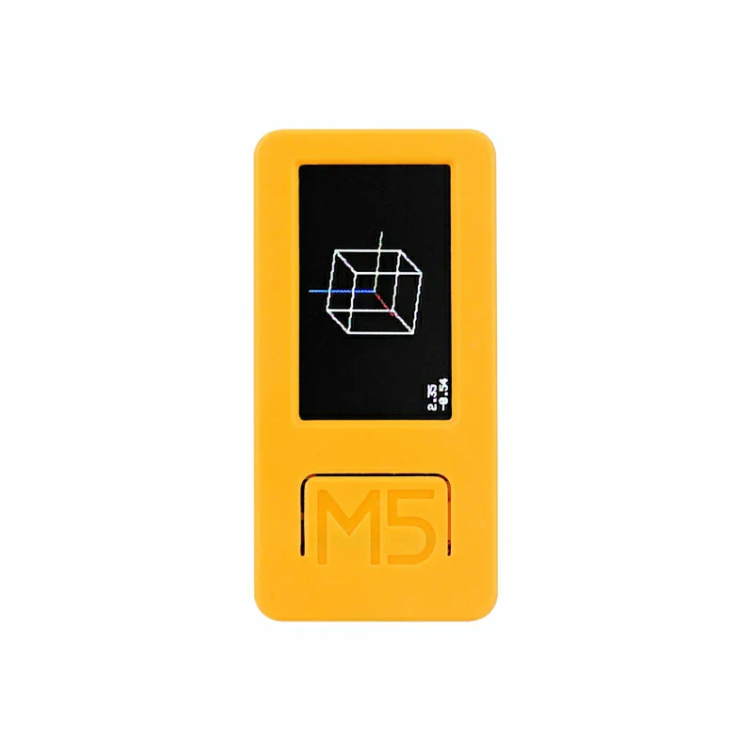
Monitoring Equipment
On top of the CIM system:
At each station:
4 QR-CODE Scanner Unit
M5Stack Core2
PaHub Splitter
Mounted on each cart:
M5StickC Plus2 IMU sensor built-in
Notes:
Shahar

Slide 7
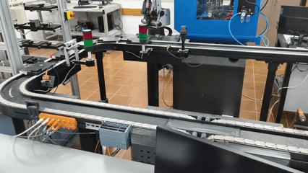
The Purpose Of The Application
The project aims to provide monitoring services and bridge the gap between industrial operations and educational training through an accessible, immersive augmented reality (AR) experience.
Notes:
Shahar
Cart Movement video

Slide 8
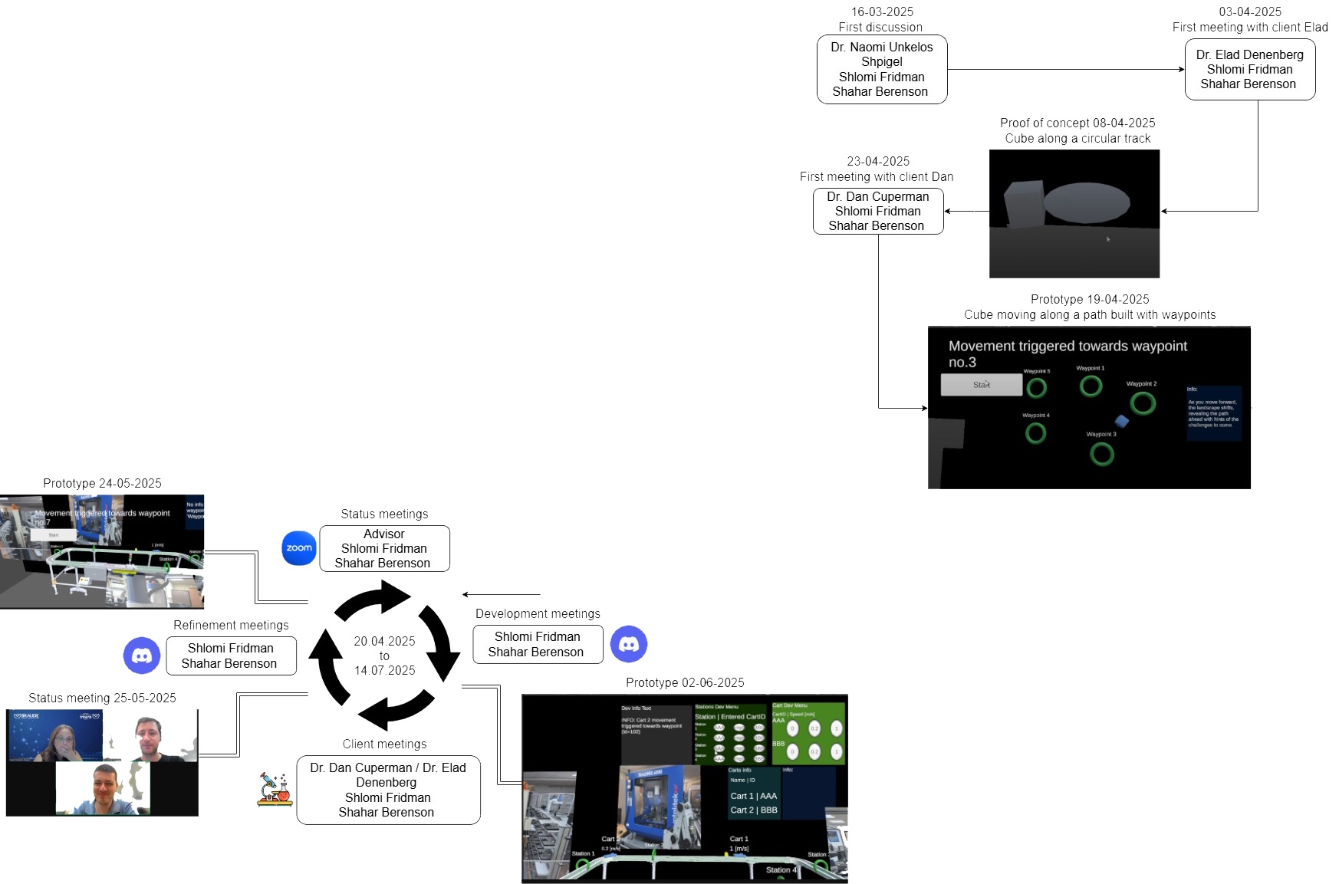
Engineering
Process
Timeline
Notes:
Shlomi
Iterative devopment process

Slide 9
Functional Requirements
AR Visualization:
Render 3D models for carts and representations of the stations.
Show cart movement along predefined waypoints.
Production Line Representation:
Tap a station to view its description, image, or video.
The cart’s speed is displayed above the cart, in meters per second.
Tracking Logic:
Carts are tracked by ID and follow a waypoint path.
An expected\predicted time is calculated for when a cart is expected at its next station.
Alerts are displayed if a cart is late to a station.
Notes:
Shlomi

Slide 10
Non-Functional Requirements
Capacity:
The system needs to support the four existing stations in the production line, i.e. display descriptions, images, etc.
Reliability:
Operate crash-free for at least 30 minutes under full load.
Graceful recovery from server disconnection.
Usability:
Touchscreen-based intuitive UI.
Performance:
The QR-Code sensor sends updates whenever there is a change in the station occupancy.
Speed data updated every 10ms.
Prediction window accuracy: ±0.5 seconds.
Notes:
Shlomi

Slide 11
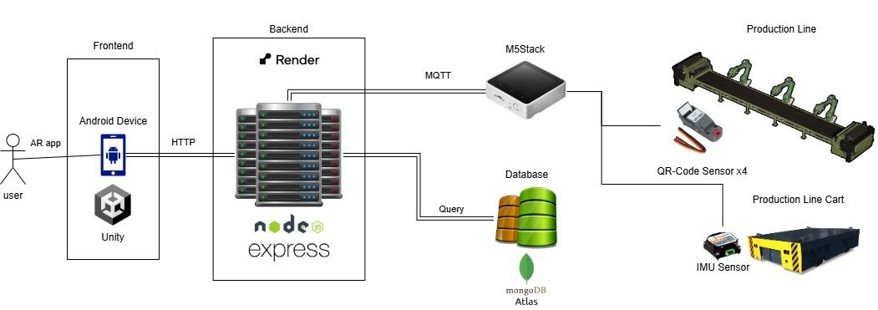
Architecture
Notes:
Shlomi

Slide 12
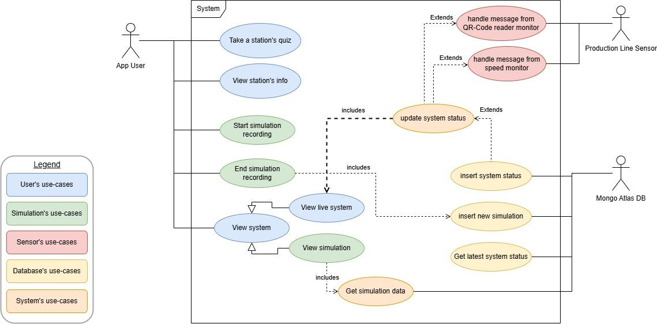
Use Case Diagram
Notes:
Shlomi

Slide 13
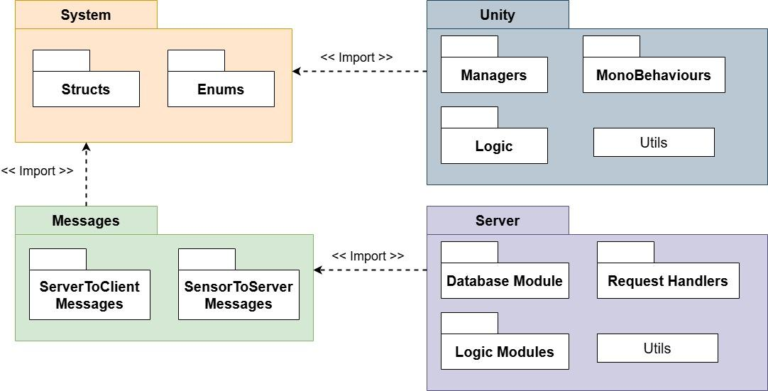
Packages
Notes:
Shlomi
Be awed!!!

Slide 14
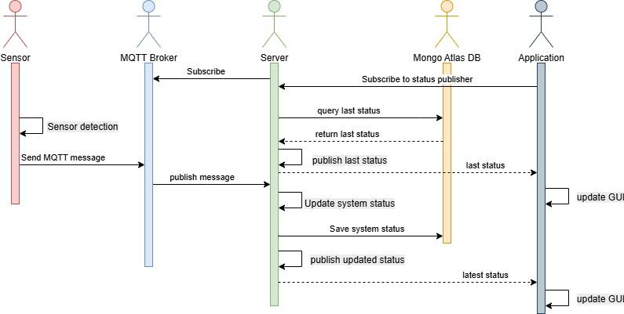
Sensor Data Sequence Diagram
Notes:
Shlomi

Slide 15
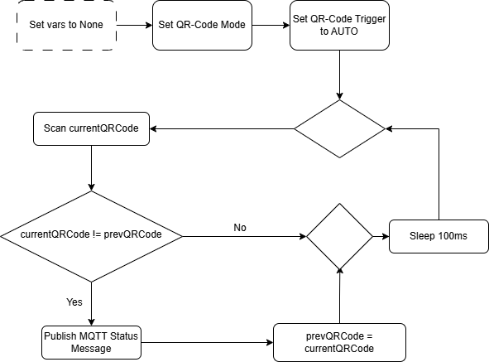
QR-Code Flowchart
Position
Notes:
Shahar

Slide 16
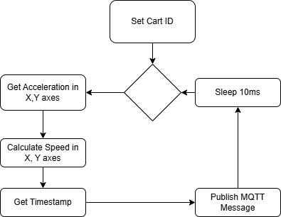
IMU Sensor Flowchart
Speed
Notes:
Shahar

Slide 17
Expected achievements
Project Outcome: Augmented Reality (AR) application on the Vuforia platform.
Target Users:
Lecturers / Lab Staff: Monitor the production line through an interactive, real-time visualisation.
Students: Explore each station and cart flow through immersive, interactive visuals.
App Features:
Monitoring service.
Educational explanations for teaching and learning.
Simulation mode for offline operation study.
Notes:
Shahar

Slide 18
KPI Metrics
User Experience:
Users are able to effectively monitor the production line in real time through the application, with accurate station status within 100ms of the real-time change.
Performance:
The cart speed data is updated at intervals of 10ms.
The predicted arrival time of a cart at any station is accurate within a margin of ±0.5sec.
Availability & Reliability:
The application is capable of handling temporary server connection losses without crashing or losing data integrity, and reconnects to the server within 1min after the crash.
Notes:
Shlomi

Slide 19
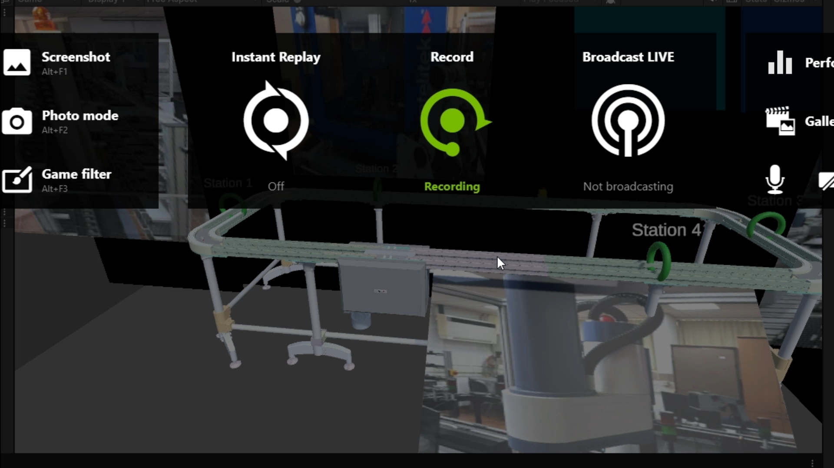
Prototype 02-06-2025
In the absence of a real server, we focused on two main tests designed to provide a believable simulation and validate the client application's logic flow.
Cart movement:
Test: Is the cart movement an accurate representation of its real-world counterpart?
Result: The virtual cart's movement accurately simulates its real-world counterpart by following plotted waypoints on the virtual production line model.
Message handling:
Test: Can the client application effectively process simulated messages regarding cart speed and station occupancy?
Result: The prototype logic successfully handles the simulated messages, updating station statuses and cart movement speed with the provided data, thus creating a believable virtual environment.
Notes:
Shlomi
Tests:
Message handling in app
Cart movement

Slide 20
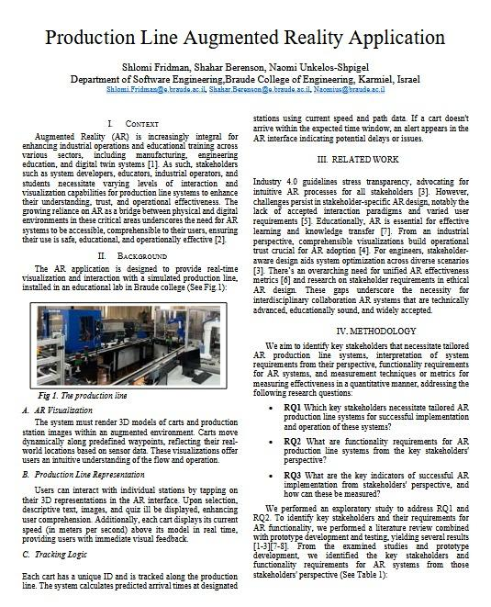

Prototype so far…
The prototype will be presented at Requirements Engineering 2025 conference in Valencia, Spain
Notes:
Shlomi
2 pages engineering process was submitted

Slide 21



Slide 22
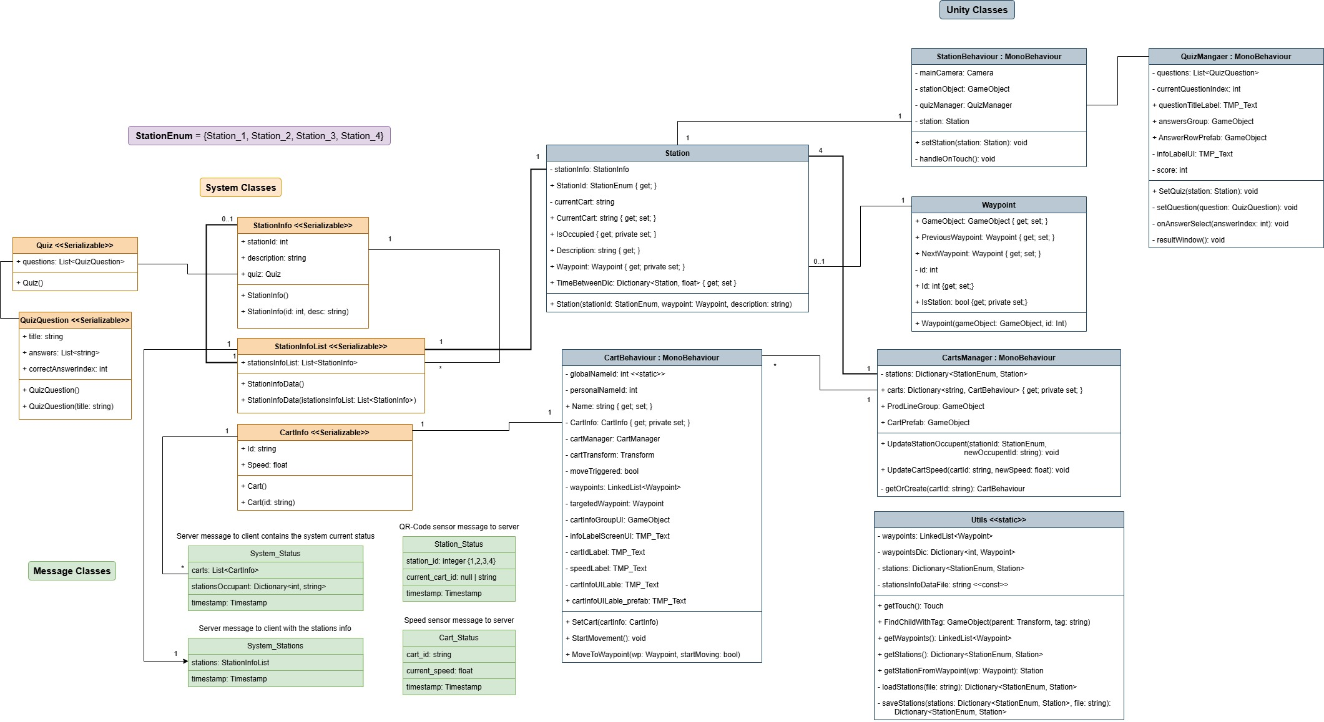
Class Diagram
Notes:
Shlomi
If there’s time

